Slide 1
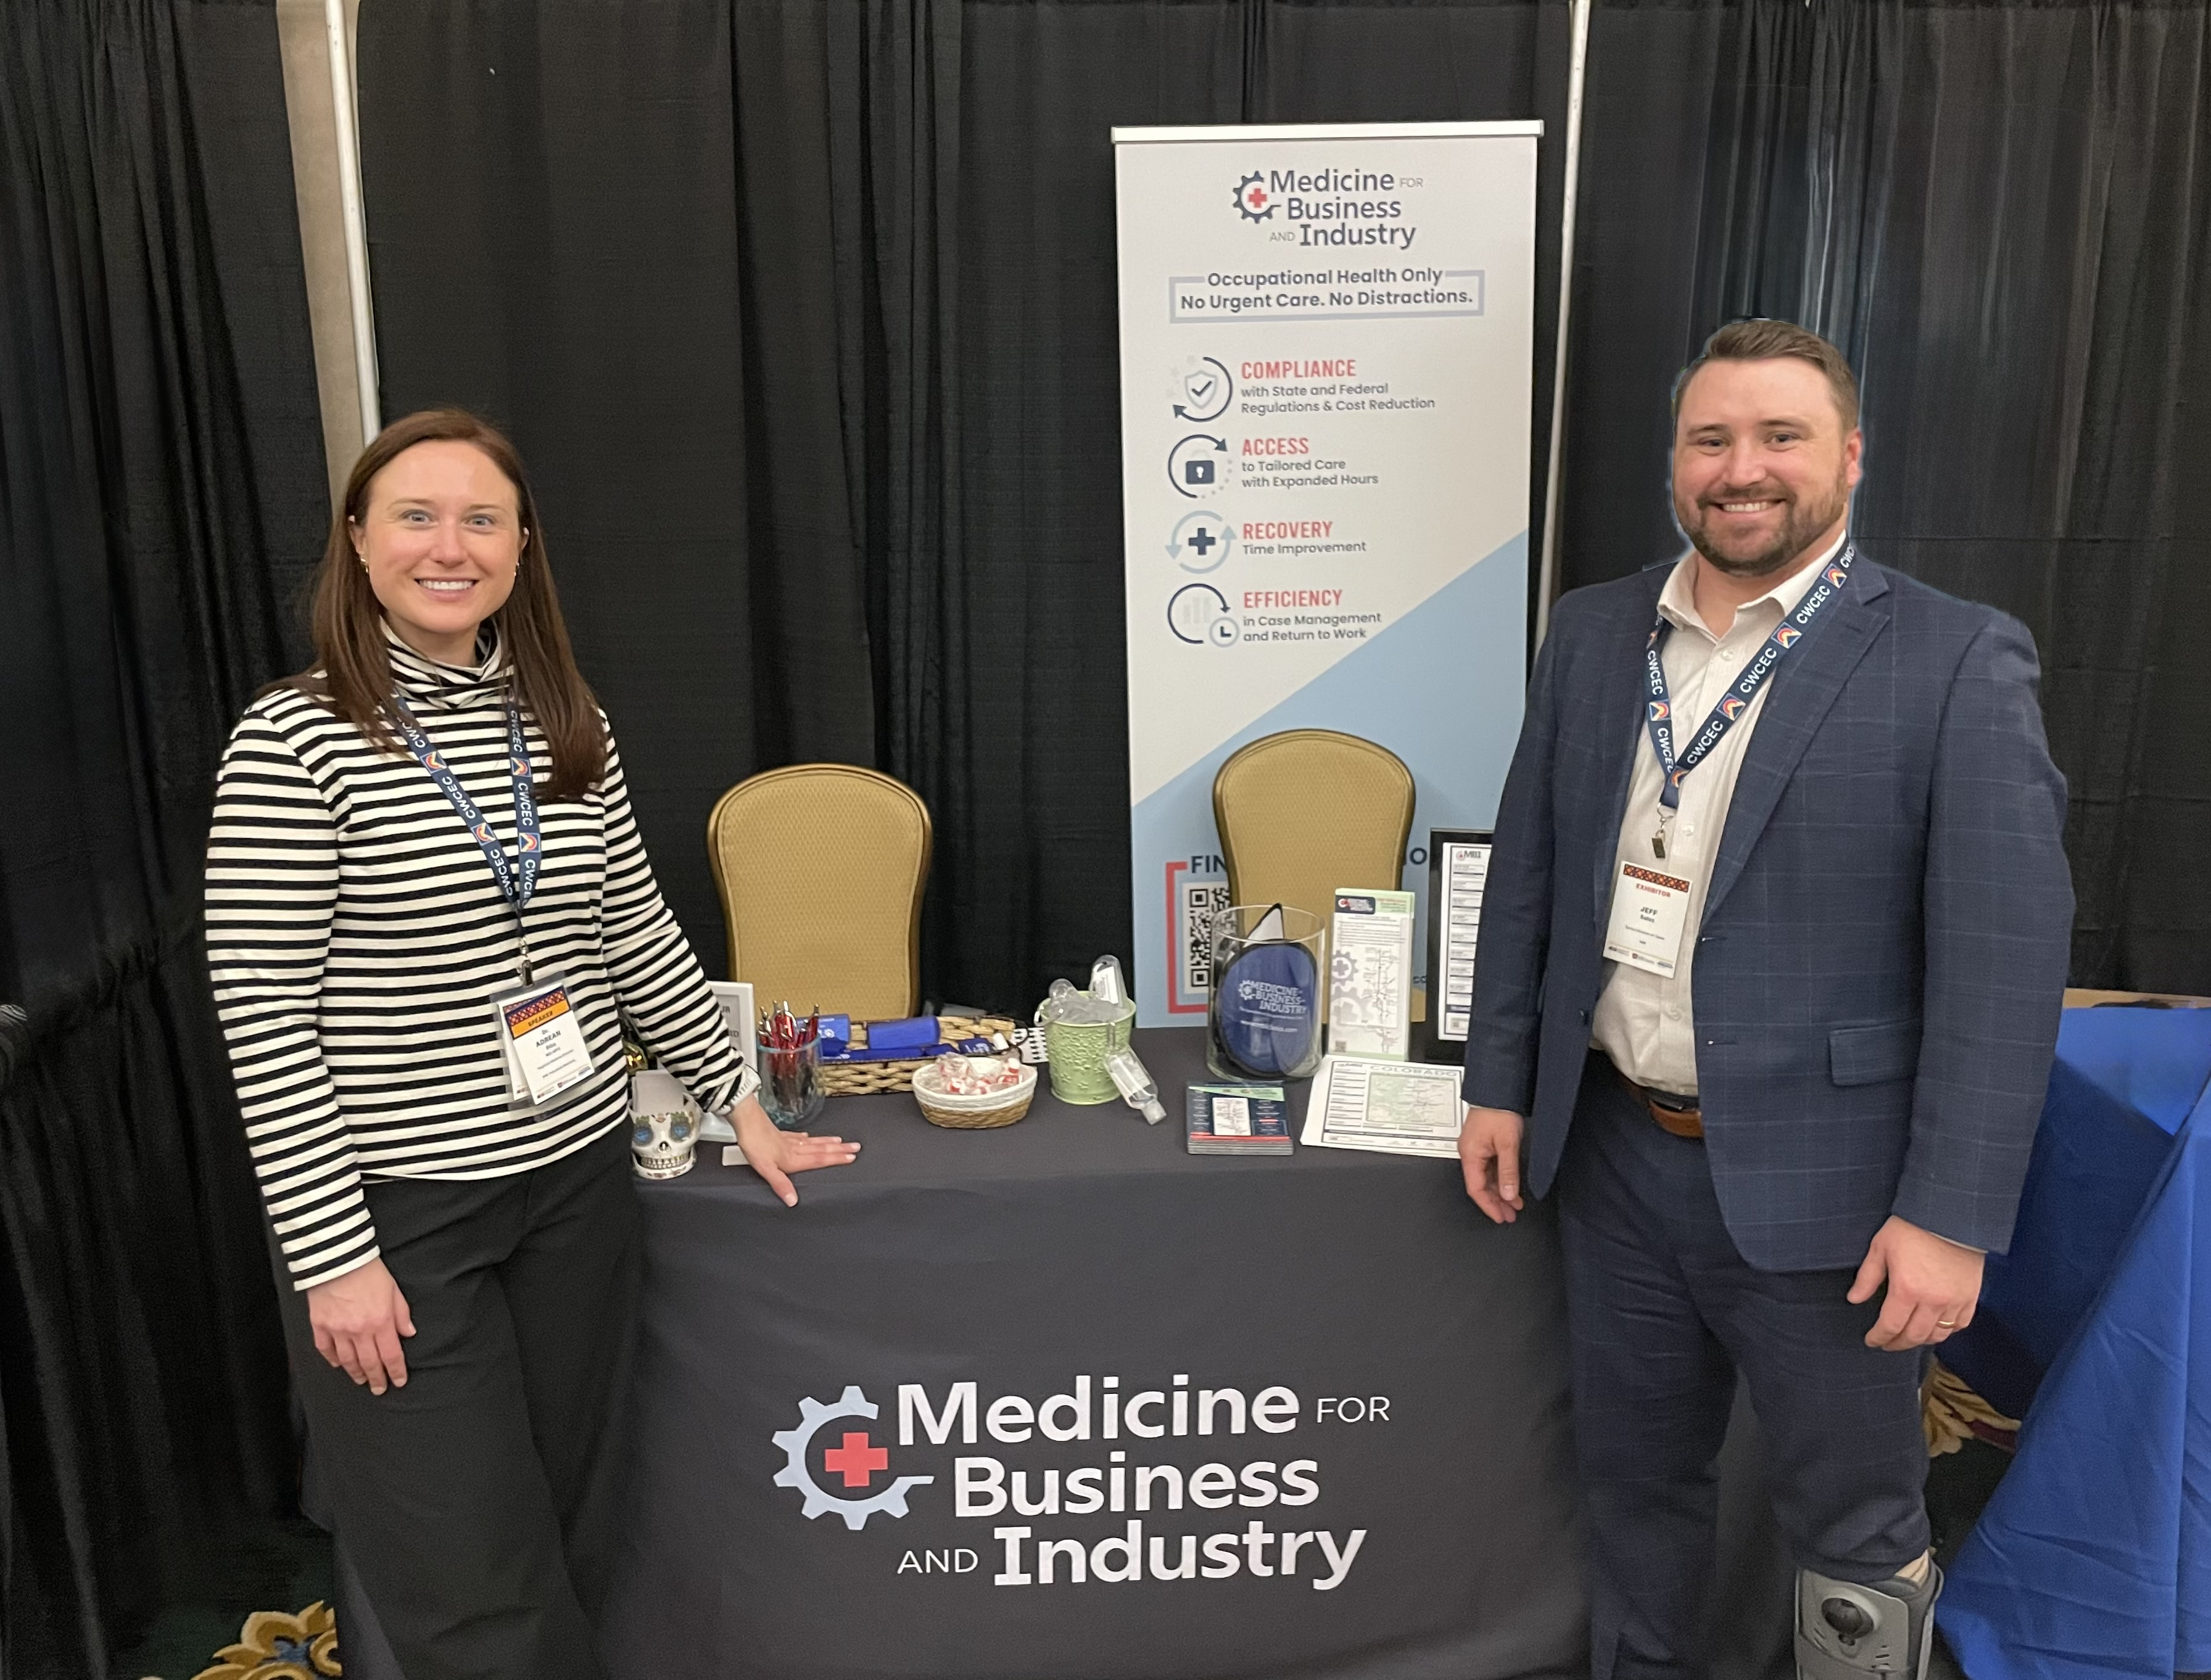
Fewer Lost Days.
Better Compliance.
Meet MBI.
Let’s explore how MBI experts can support your occupational health needs.
Come visit us @ Booth xxx
www.mbiclinics.com

