Slide 1


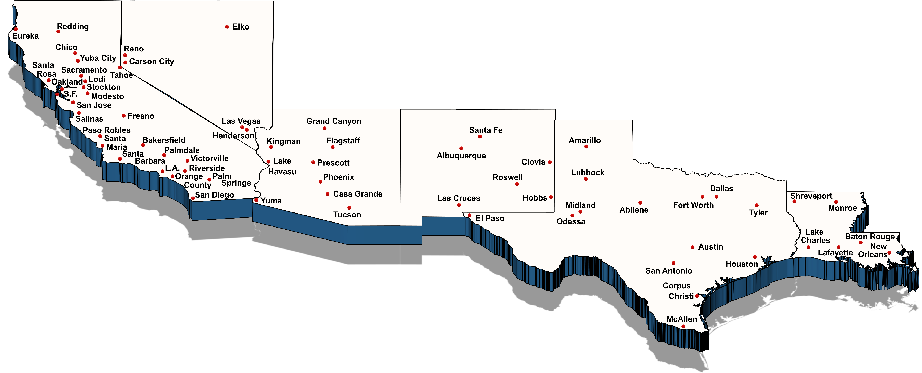
ON-SITE • CATASTROPHIC • RUSH • TELEPHONIC
NURSE CASE MANAGEMENT
C A • N V • A Z • N M • T X • L A
ISYS® provides high quality Nurse Case Management services throughout:﻿
California, Nevada, Arizona, New Mexico, Texas, and Louisiana

